Slide 1

Data Analytics Capstone Project
By. Ethan Tornga

Slide 2
Research Question
Domain – Master’s Degree decision making
Specific Problem – What factors have the most influence over a student's decision to pursue an MBA?
Gather insights from research done and potential surveys
This will be helpful for context and validation when presenting

Slide 3

The Data
MBA Decision Dataset
10,000 Students
19 Columns
Numerical + Categorical Data
Kaggle

Slide 4
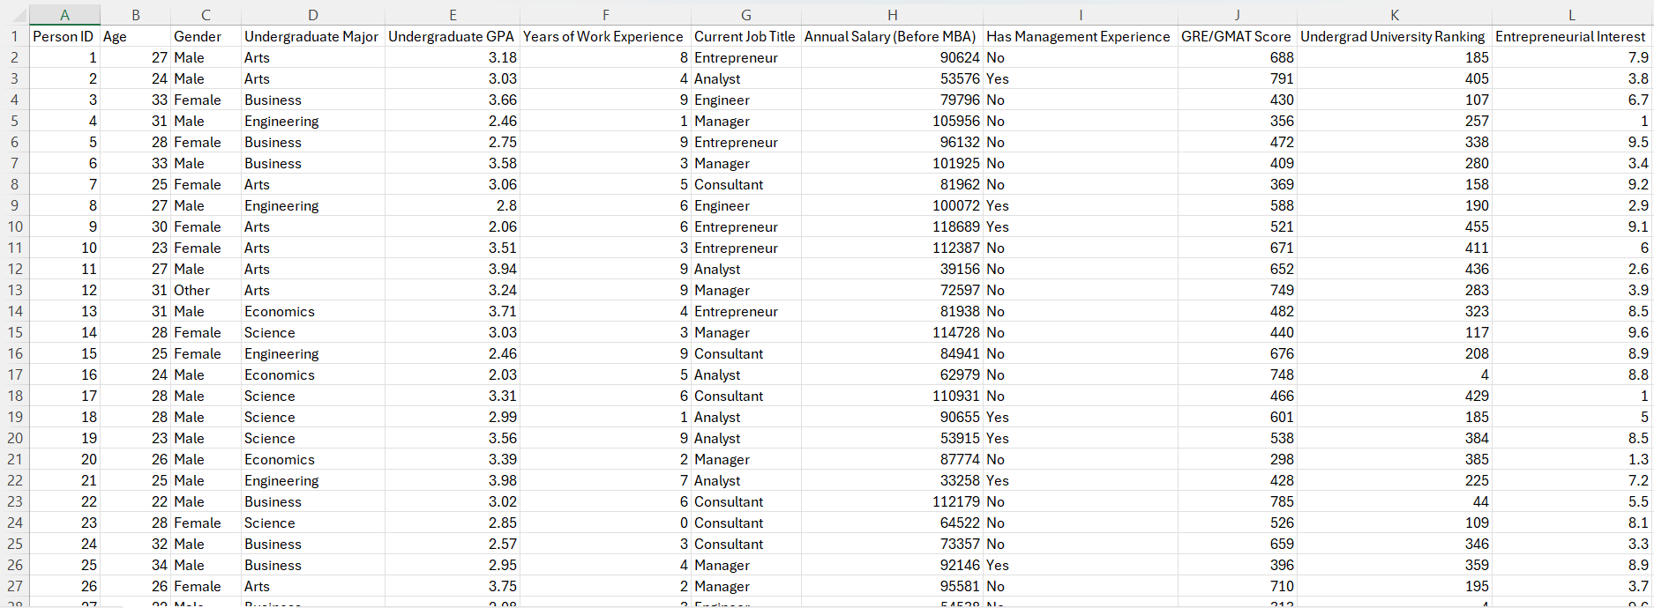
Dataset

Slide 5
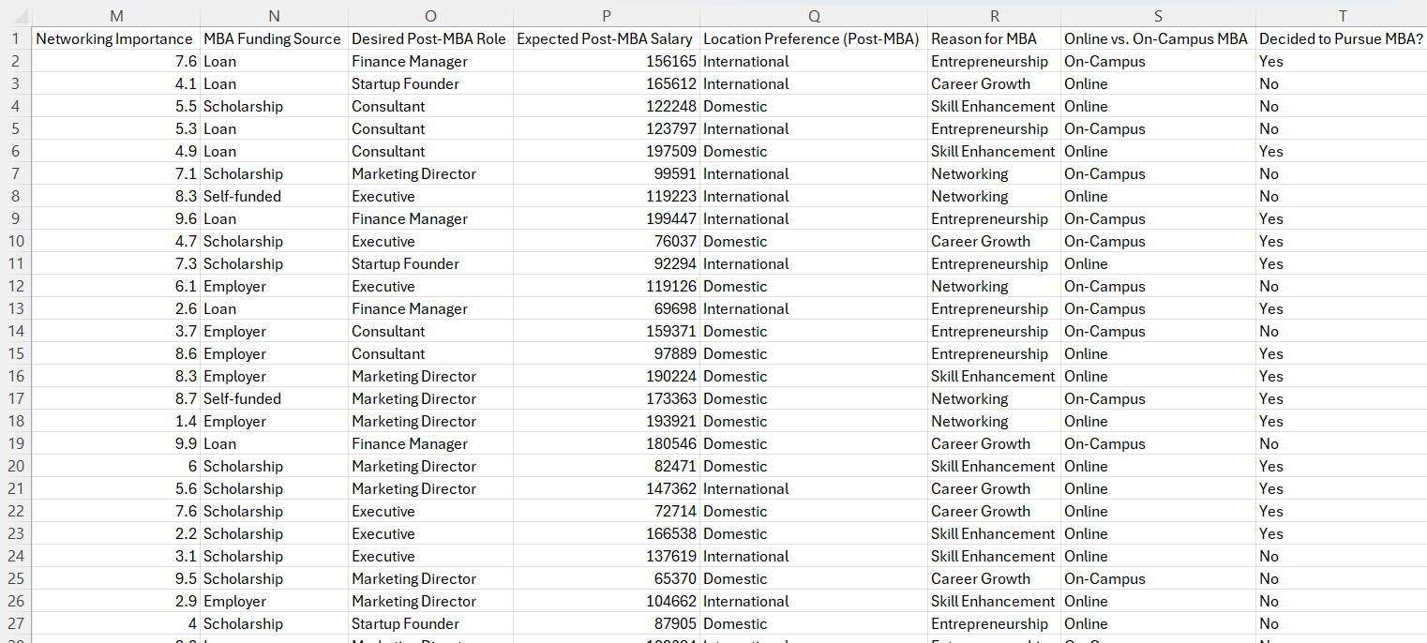
Dataset

Slide 6
SQL Querying
Dropped Entrepreneurial Interest column
Dropped Networking Importance column
Created Salary Difference column
Created Percent of Life Worked column
Create 5 KPIs to help better understand the data

Slide 7
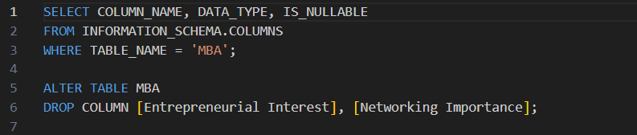
Dropped Columns

Slide 8
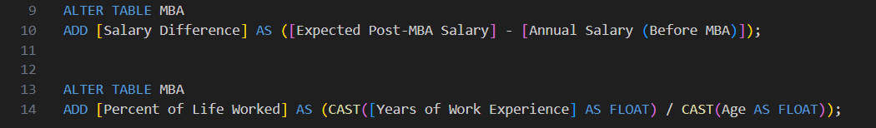
Created Columns

Slide 9
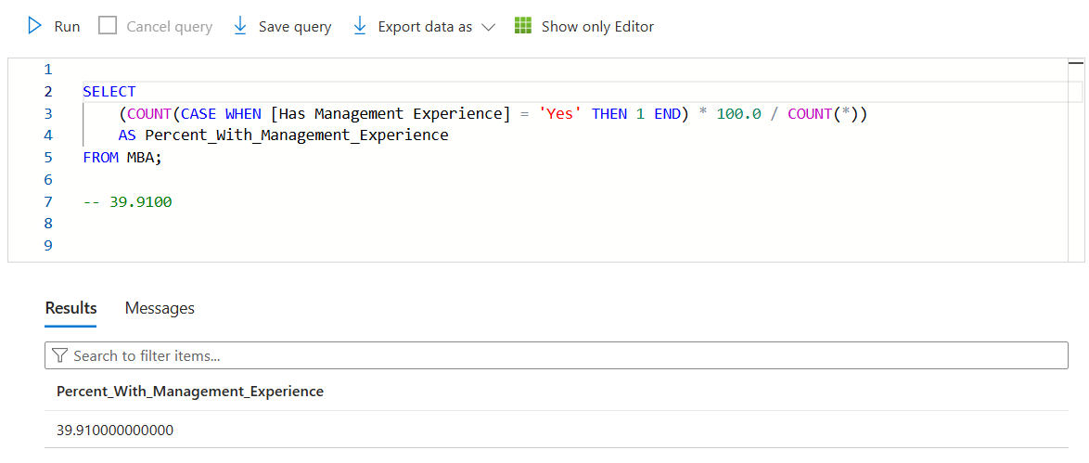
KPIs

Slide 10
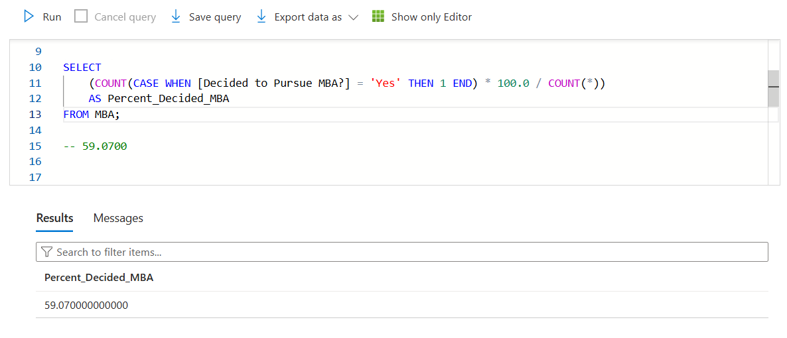
KPIs

Slide 11
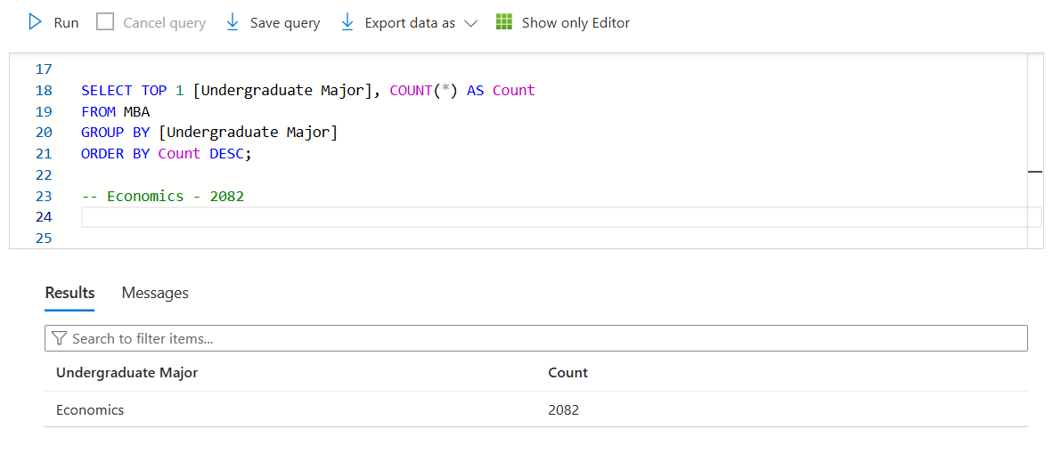
KPIs

Slide 12
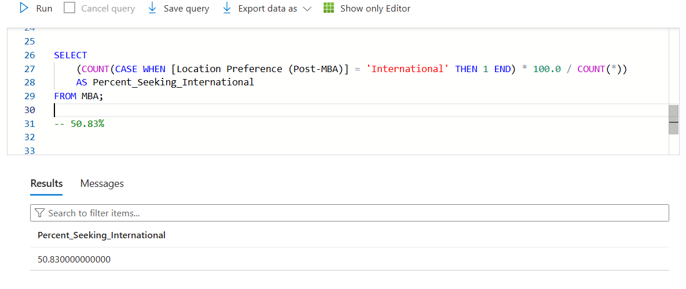
KPIs

Slide 13
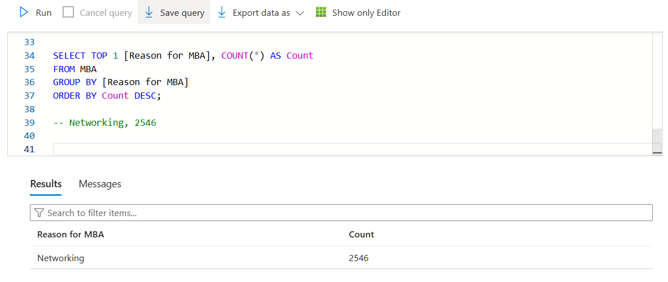
KPIs

Slide 14
Data Management
Cleaning
Checking for outliers, potentially removing columns
1
Wrangling
Deciding what columns to keep/remove/add
2
Preparing
Adding columns
3

Slide 15
Python
MSE and RMSE
Multiple Model Evaluations
Random Forest Classifier
Feature Importance
KNN
Confusion Matrices

Slide 16
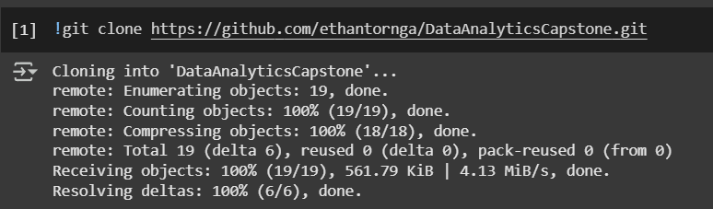
Connection

Slide 17
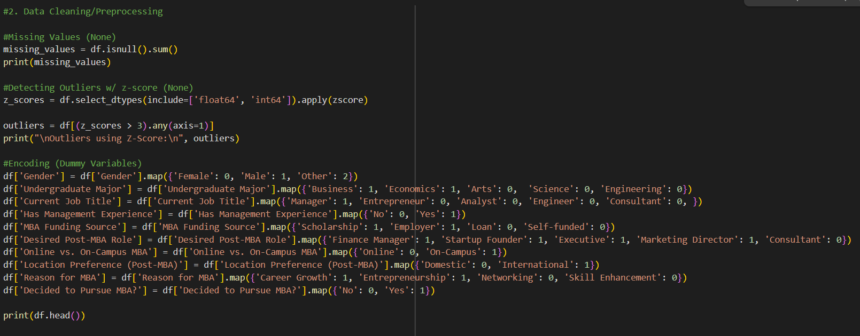
Cleaning and Preprocessing

Slide 18
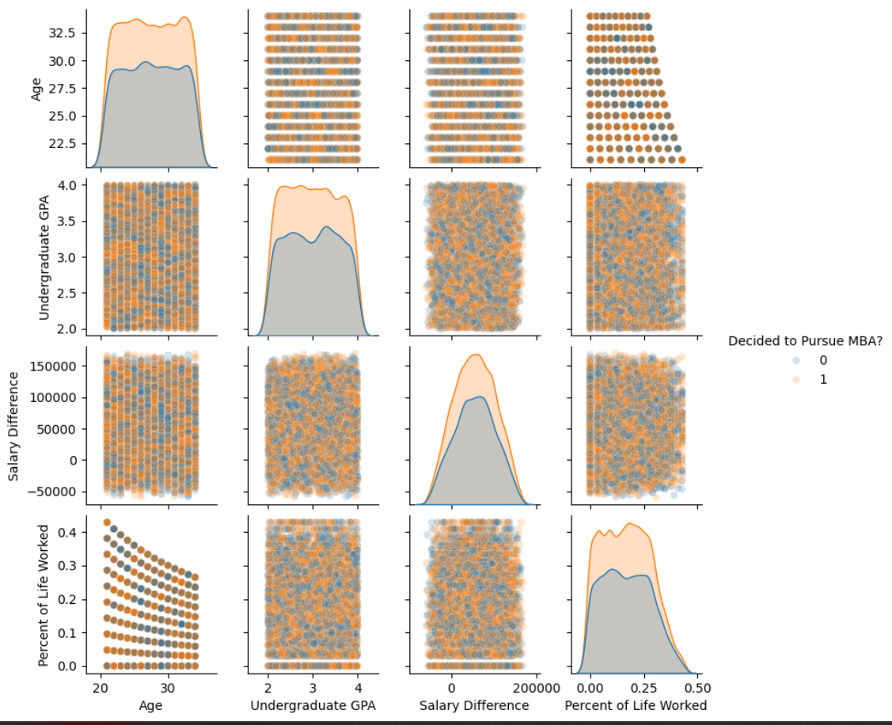
Seaborn Pair Plot for Data Introduction

Slide 19
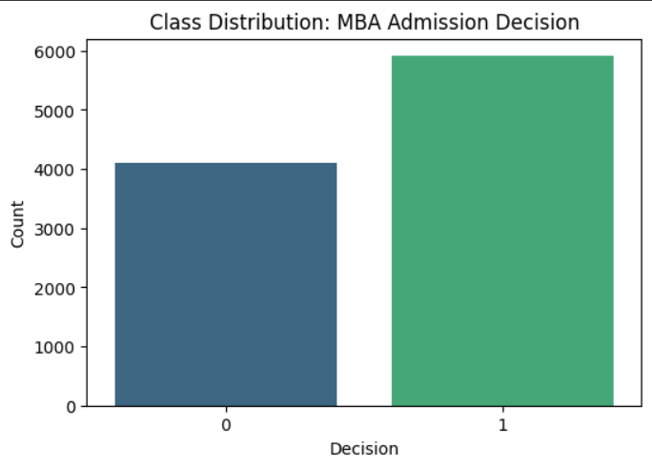
Decision Distribution

Slide 20
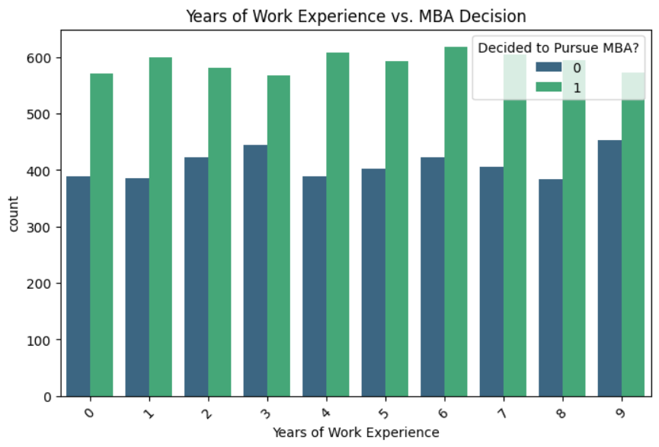
Work Experience vs Decision

Slide 21
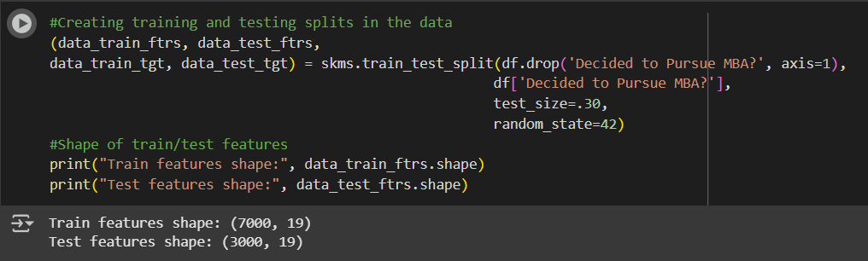
Train / Test Splits

Slide 22
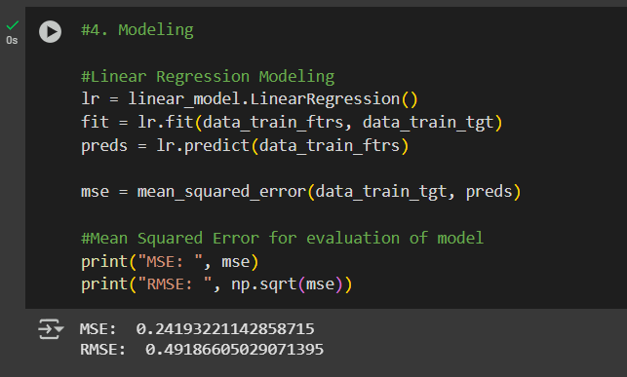
MSE and RMSE

Slide 23
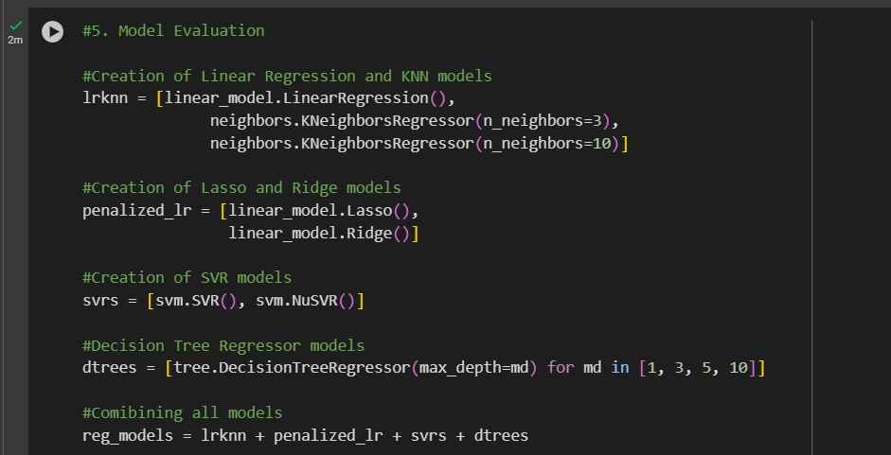
Multiple Model Creation

Slide 24
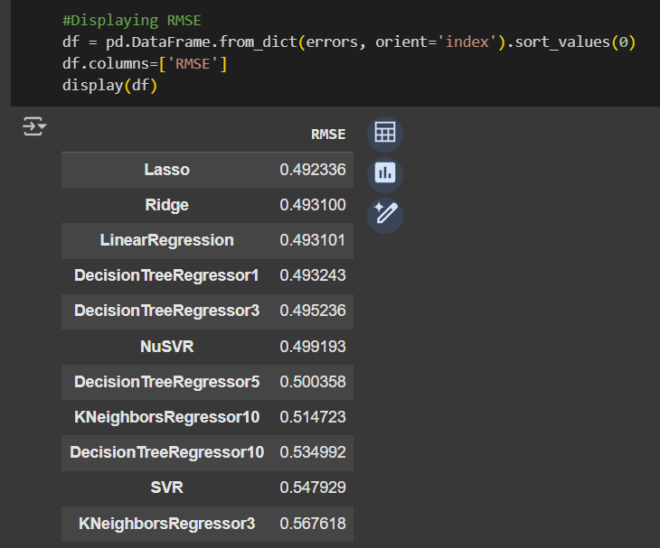
RMSE Results

Slide 25
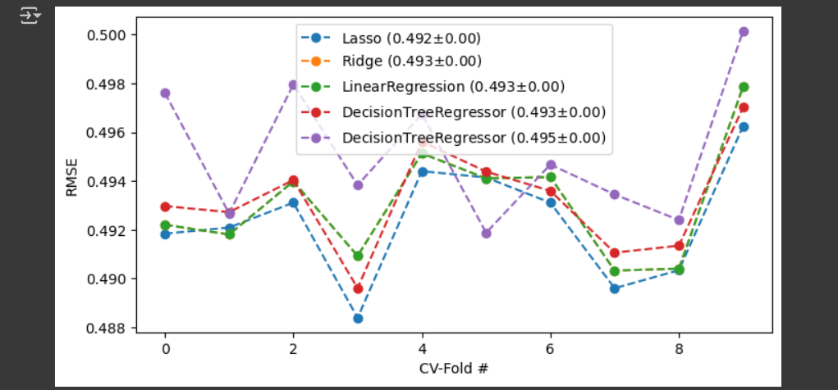
Top Models CV-Fold Graph

Slide 26
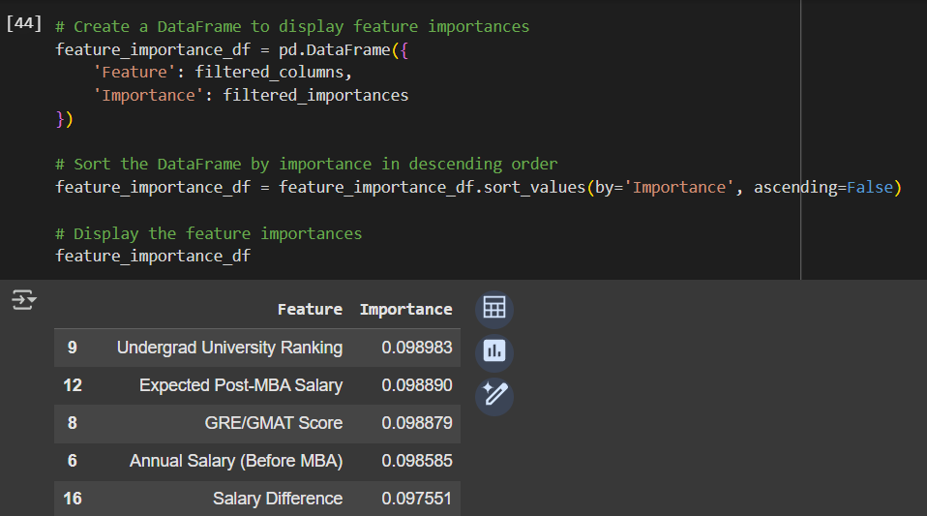
Feature Importance

Slide 27
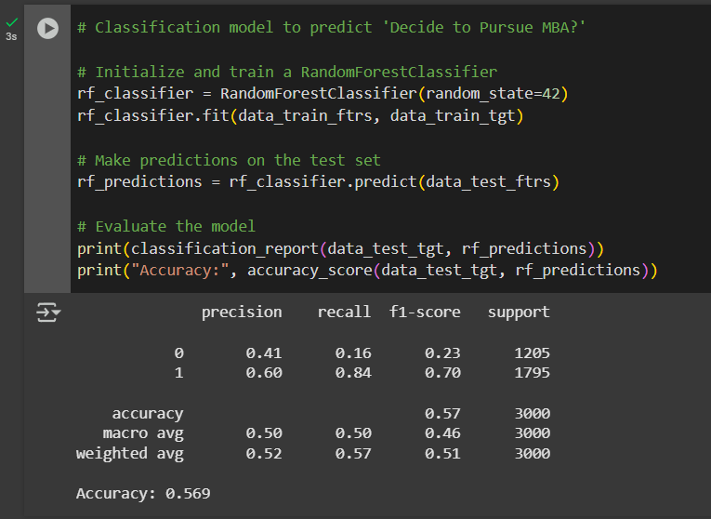
Random Forest Classification Model

Slide 28
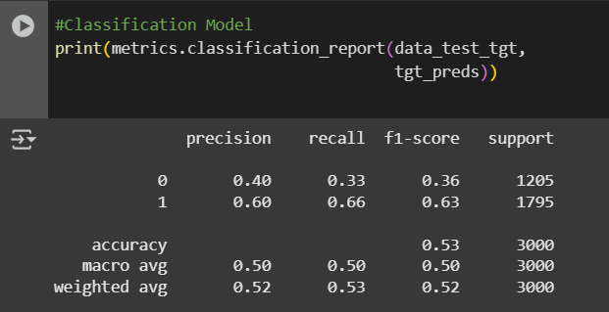
Classification Model

Slide 29
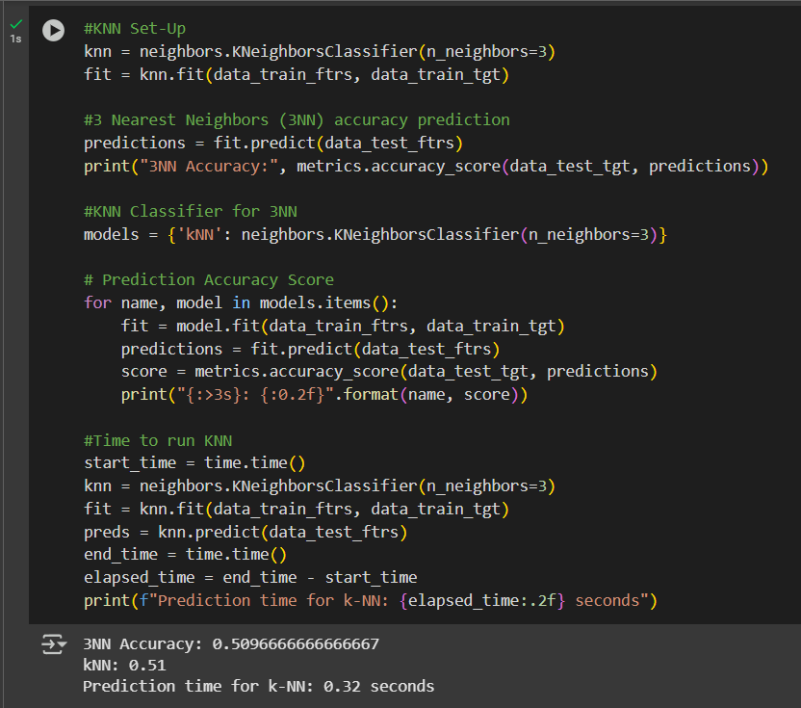
KNN

Slide 30
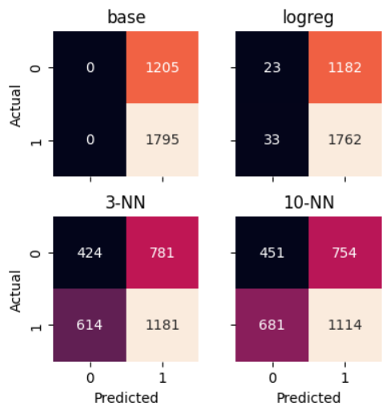
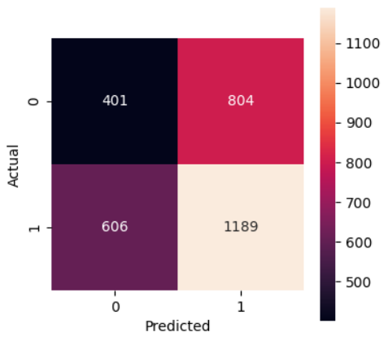
Confusion Matrices

Slide 31
Visualizations
Power BI
Individual slides for different key metrics
Main interactive dashboard for all key metrics

Slide 32
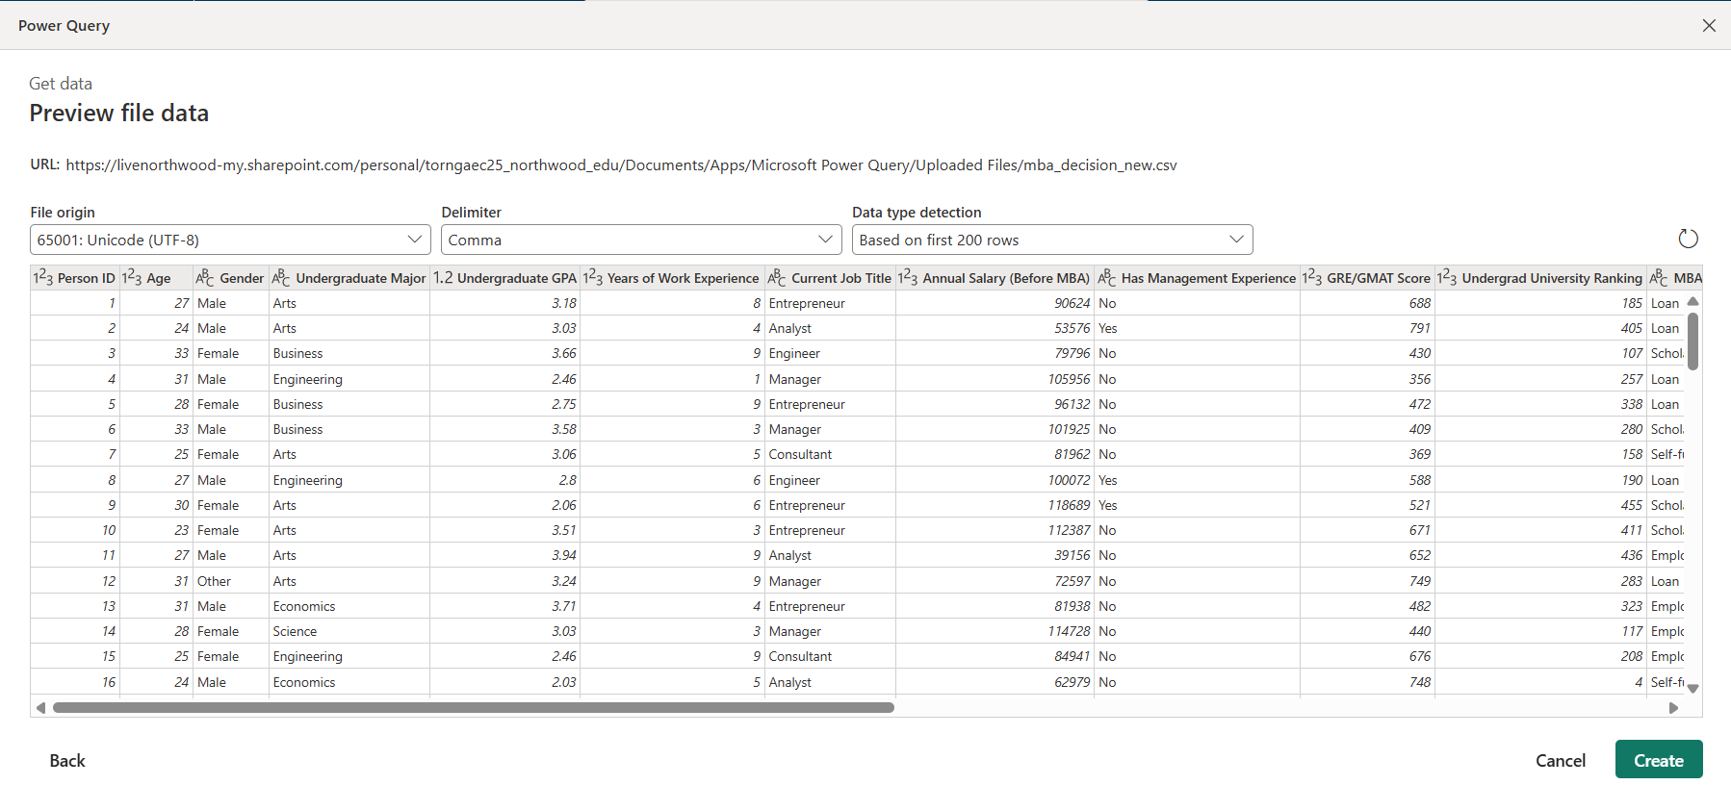
Power Query

Slide 33
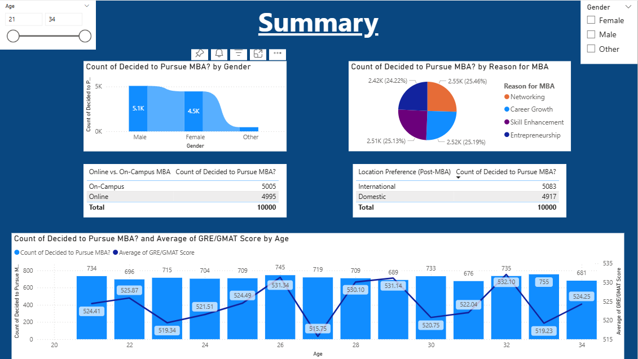
Power BI

Slide 34
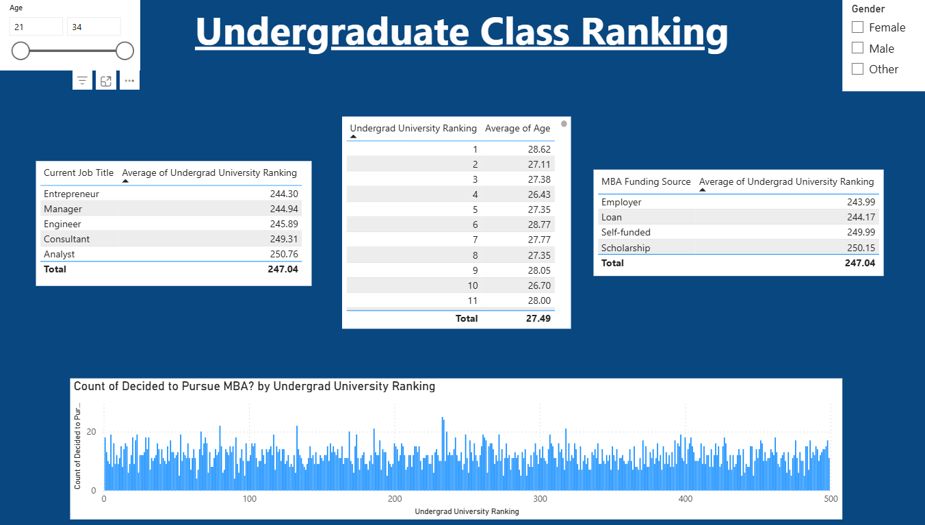
Power BI

Slide 35
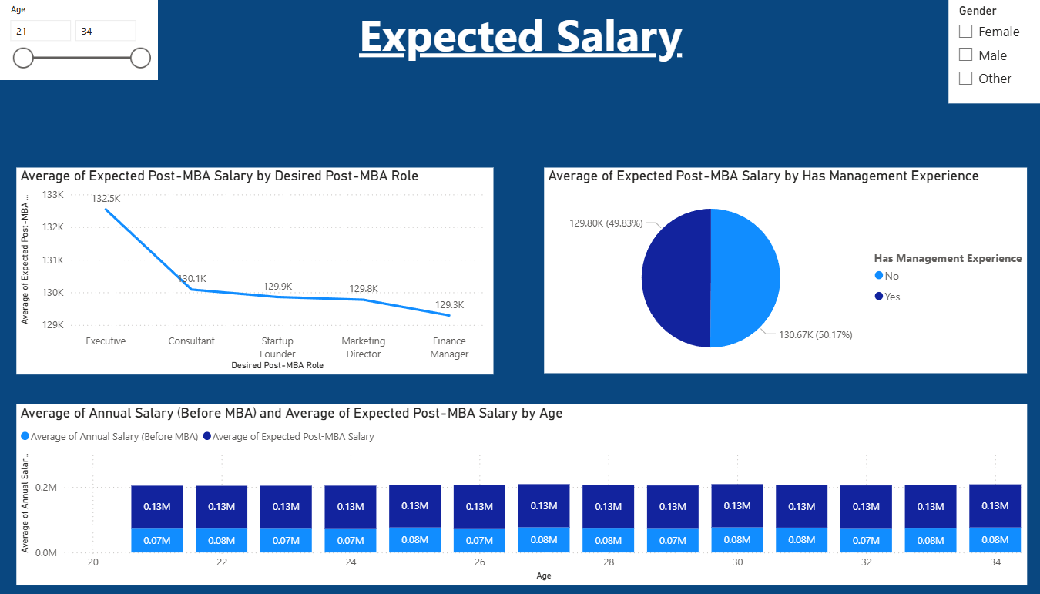
Power BI

Slide 36
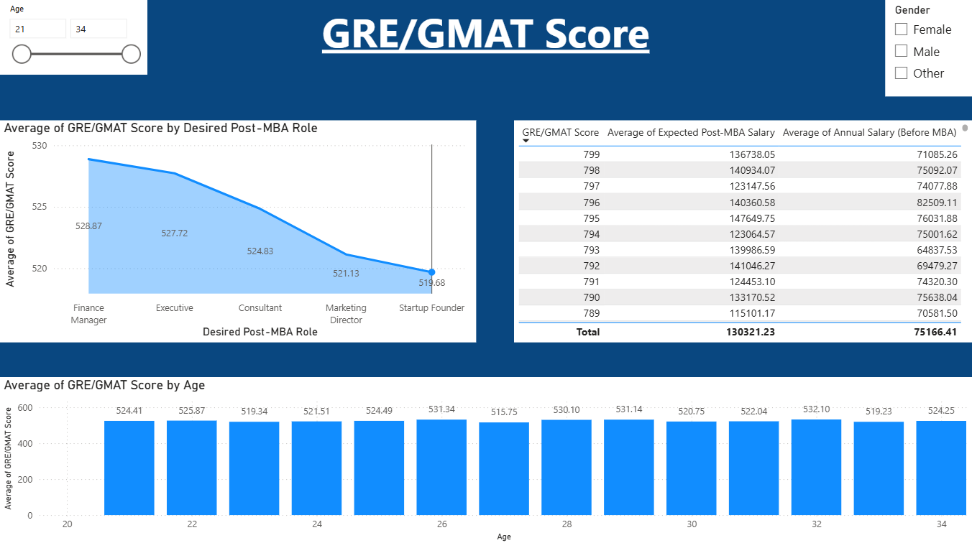
Power BI

Slide 37
Final Analysis
Best performing model was the Random Forest Classifier with an accuracy of 56.9 percent
In terms of RMSE the Lasso, Ridge, and Linear Regression models performed the best, all under 0.50
Feature importance played a key role in analysis and visualization direction
Many variables with little relationships led to difficulties in analysis

Slide 38
Actionable Recommendations
Provide resources such as tutoring to help improve class ranking
Discuss salary improvements that MBA can have with undergraduate students
Study guides and learning sessions to help with GRE and GMAT tests

Slide 39
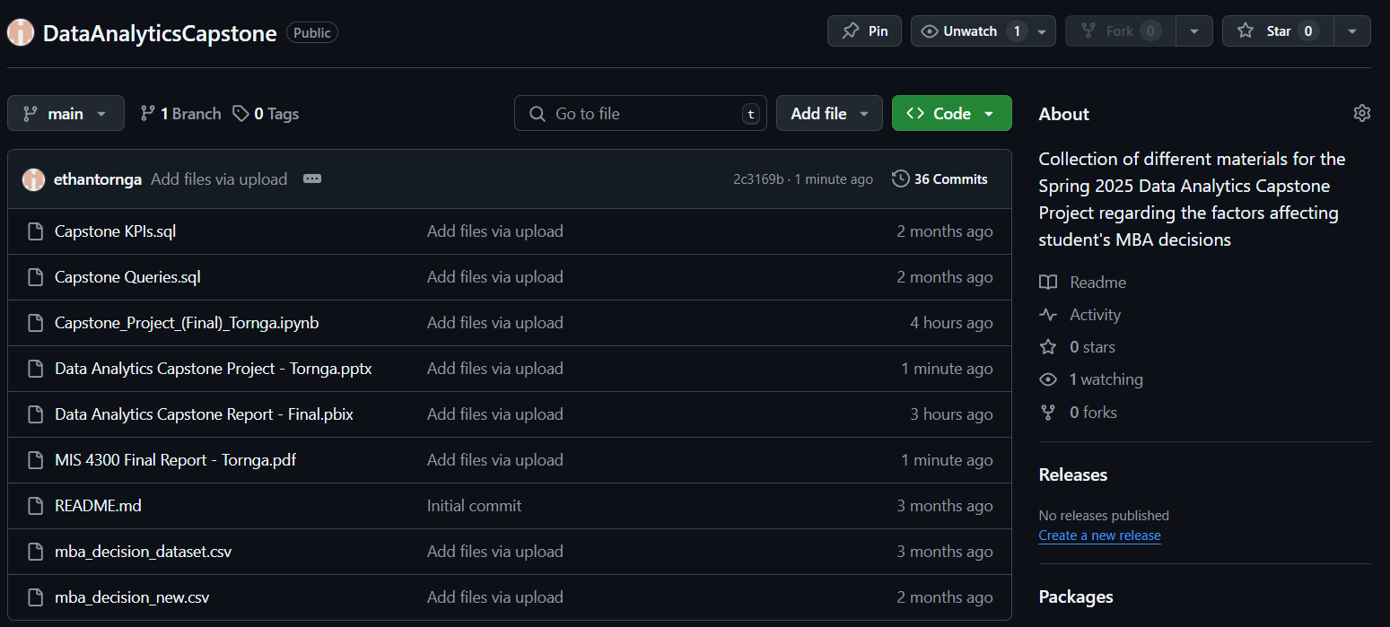
GitHub Repository

Slide 40
References
Cote, C. (2022, November 8). 7 Benefits of Getting an MBA: HBS Online. Business Insights Blog. https://online.hbs.edu/blog/post/benefits-of-getting-an-mba
Fenner, M. E. (2022). Machine Learning with Python for Everyone. Pearson Addison-Wesley Professional.

